Slide 1

Department of CSE
Course: AI & ML
Course code: 24AD2001A
Topic:
Automated ML: Pipeline automation (sklearn, PyCaret), experiment tracking (MLflow).
Session – 37

Slide 2
Automated ML: Pipeline automation (sklearn, PyCaret)
A Machine Learning Pipeline is a systematic workflow designed to automate the process of building, training, and deploying of ML models. It includes several steps, such as data collection, preprocessing, feature engineering, model training, evaluation and deployment.
Rather than managing each step individually, pipelines help simplify and standardize the workflow, making machine learning development faster, more efficient and scalable. They also enhance data management by enabling the extraction, transformation, and loading of data from various sources.

Slide 3
Benefits of Machine Learning pipeline
A Machine Learning Pipeline offers several advantages by automating and streamlining the process of developing, training and deploying machine learning models. Here are the key benefits:
1. Automation and Efficiency: It automates the repetitive tasks such as data cleaning, model training and testing. It saves time and speeds up the development process and allows data scientists to focus on more strategic task.
2. Faster Model Deployment: It helps in quickly moving a trained model into real-world use. It is useful for AI applications like stock trading, fraud detection and healthcare.
3. Improve Accuracy & Consistency: It ensures that data is processed the same way every time reducing human error and making predictions more reliable.
4. Handles Large Data easily: ML pipeline works efficiently with big datasets and can run on powerful cloud platforms for better performance.
5. Cost-Effective: Machine Learning Pipeline saves time and money by automating tasks that would normally require manual work. This means fewer mistakes and less work for extra workers, making the process more efficient and cost-effective.

Slide 4
Pipelines for Automating Machine Learning Workflows
There are standard workflows in applied machine learning. Standard because they overcome common problems like data leakage in your test harness.
Python scikit-learn provides a Pipeline utility to help automate machine learning workflows.
Pipelines work by allowing for a linear sequence of data transforms to be chained together culminating in a modeling process that can be evaluated.
The goal is to ensure that all of the steps in the pipeline are constrained to the data available for the evaluation, such as the training dataset or each fold of the cross validation procedure.

Slide 5
Usecase 1: Pipeline 1: Data Preparation and Modeling
An easy trap to fall into in applied machine learning is leaking data from your training dataset to your test dataset.
To avoid this trap you need a robust test harness with strong separation of training and testing. This includes data preparation.
Data preparation is one easy way to leak knowledge of the whole training dataset to the algorithm. For example, preparing your data using normalization or standardization on the entire training dataset before learning would not be a valid test because the training dataset would have been influenced by the scale of the data in the test set.
Pipelines help you prevent data leakage in your test harness by ensuring that data preparation like standardization is constrained to each fold of your cross validation procedure.
The example below demonstrates this important data preparation and model evaluation workflow. The pipeline is defined with two steps:
Standardize the data. Learn a Linear Discriminant Analysis model. The pipeline is then evaluated using 10-fold cross validation.

Slide 6
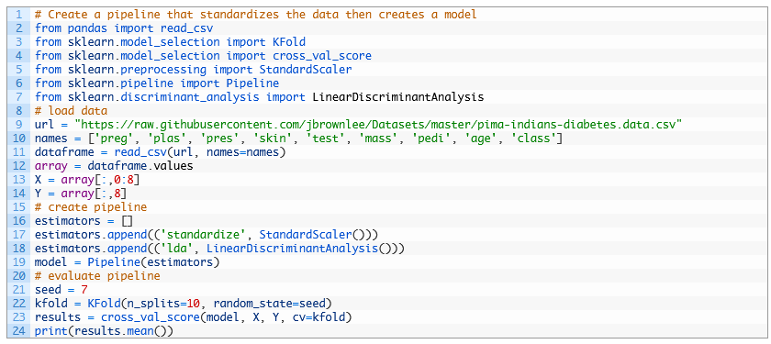
CONTD..
Running the example provides a summary of accuracy of the setup on the dataset.
0.773462064252

Slide 7
PyCaret
PyCaret is an open-source, low-code machine learning library in Python that automates machine learning workflows. It is an end-to-end machine learning and model management tool that exponentially speeds up the experiment cycle and makes you more productive.
Compared with the other open-source machine learning libraries, PyCaret is an alternate low-code library that can replace hundreds of lines of code with a few lines only. This makes experiments exponentially faster and more efficient. PyCaret is essentially a Python wrapper around several machine learning libraries and frameworks such as scikit-learn, XGBoost, LightGBM, CatBoost, spaCy, Optuna, Hyperopt, Ray, and a few more.

Slide 8
CONTD..
PyCaret is simple and easy to use. All the operations performed in PyCaret are sequentially stored in a pipeline that is fully orchestrated for deployment. Whether it’s imputing missing values, transforming categorical data, feature engineering, or even hyperparameter tuning, PyCaret automates all of it.
How to Install PyCaret:
pip install pycaret
Check PyCaret Version
print(pycaret.__version__)

Slide 9
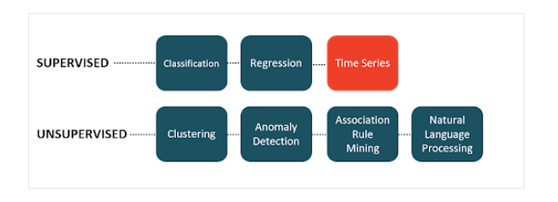
Modules in PyCaret
PyCaret’s API is arranged in modules. Each module supports a type of supervised learning (classification and regression) or unsupervised learning (clustering, anomaly detection, nlp, association rules mining). A new module for time series forecasting was released recently under beta as a separate pip package.

Slide 10
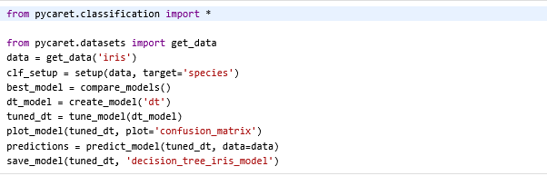
Modules in PyCaret
1. Classification: This script uses PyCaret’s Classification module to automate the machine learning process on the Iris dataset. It initializes the setup with setup() compares different classification models to pick the best one with compare_models() then specifically creates (create_model()) and tunes (tune_model()) a Decision Tree classifier.
It visualizes the model’s performance with a confusion matrix (plot_model()) makes predictions on the data (predict_model()) and finally saves the trained and tuned model to disk (save_model()) for later reuse.

Slide 11
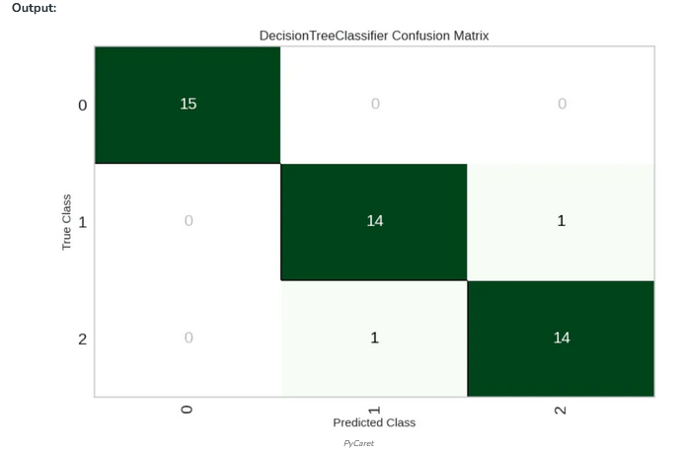
CONTD..

Slide 12
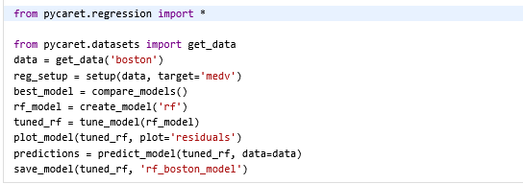
CONTD..
2. Regression
This script uses PyCaret’s regression module to build a machine learning model on the Boston housing dataset.
It sets up the workflow with setup() compares multiple regression models to select the best one with compare_models() then creates (create_model()) and tunes (tune_model()) a Random Forest Regressor.
It visualizes model performance with a residuals plot (plot_model()), makes predictions on the data (predict_model()) and saves the tuned model to disk (save_model()) for future use.

Slide 13
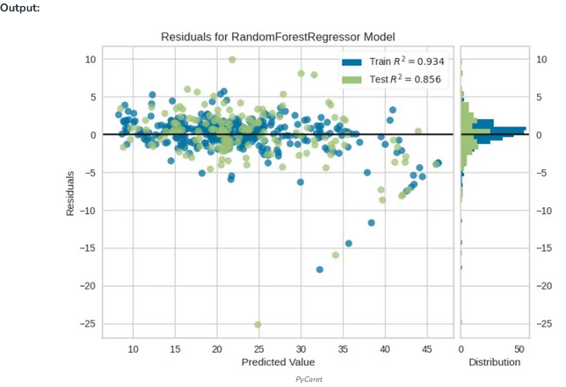
CONTD..

Slide 14
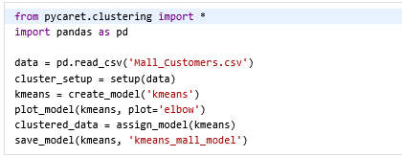
CONTd..
3. Clustering
This script uses PyCaret’s clustering module to perform unsupervised learning on the Mall Customers dataset. It initializes the clustering setup with setup(), creates a KMeans clustering model with create_model(), visualizes the optimal number of clusters using an elbow plot (plot_model()), assigns cluster labels to the original data (assign_model()) and saves the trained KMeans model to disk (save_model()) for future use.

Slide 15
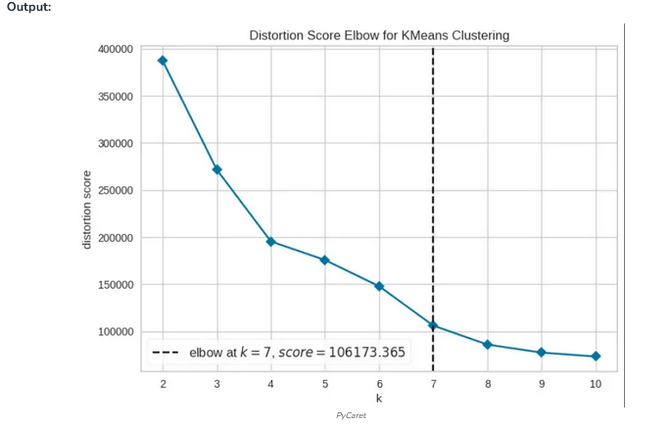
CONTd..

Slide 16
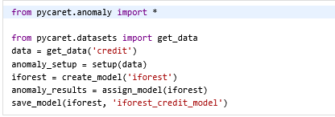
CONTd..
4. Anomaly detection
This script uses PyCaret’s anomaly detection module to detect outliers in the credit dataset. It initializes the setup with setup(), creates an Isolation Forest model (create_model('iforest')), assigns anomaly labels to the data (assign_model()) and saves the trained model (save_model()) so it can be reused later for detecting anomalies.

Slide 17
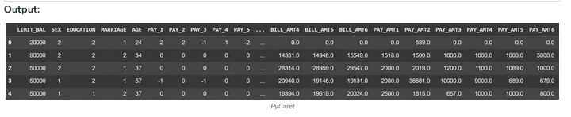
CONTd..

Slide 18
THANK YOU
Team – AI &ML

